Slide 1


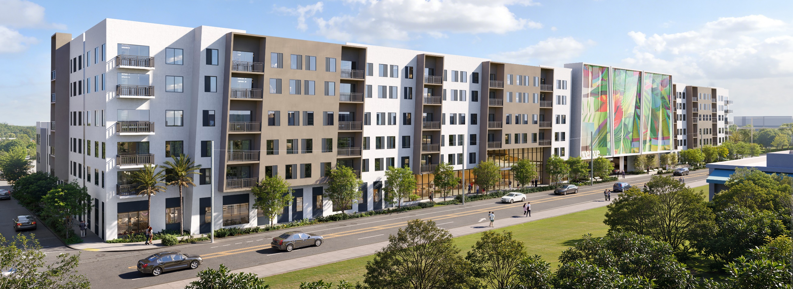
Dvisory B
South Miami City Commission
April 21, 2026 PB-2026-007
Large-Scale Development
Special Exception
Site Plan Review & Variance

Slide 2
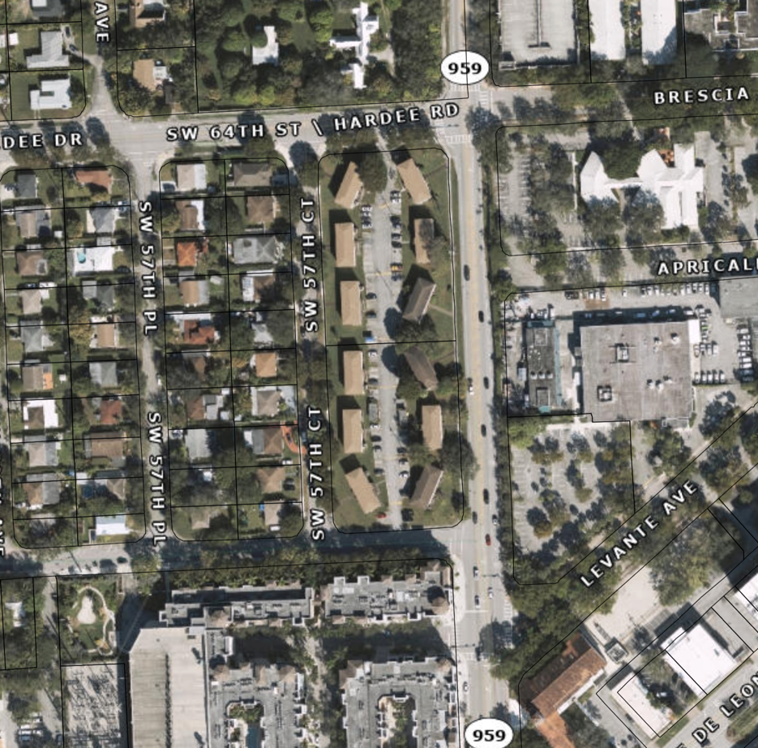
LOCATION:
6404 & 6504 Red Road
full block:
east of Red Road
east of SW 57th Court
north of SW 66the Steet
south of SW 64th Street
2.73 acres, 119,086 sq. ft.
Existing Use: 48 apartments
RM-18
FLUM Designation: TSD
Zoning Designation: TSDD
TSDD Sub-Zone: TSNA
x

Slide 3
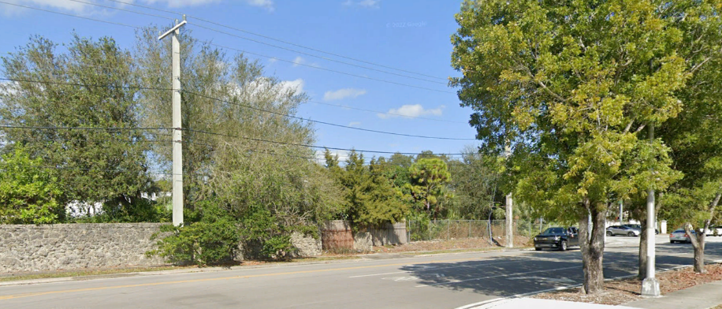
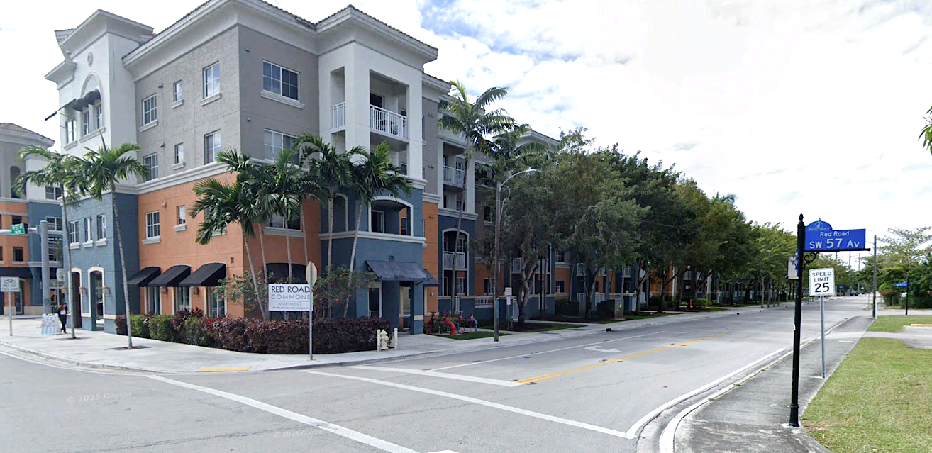
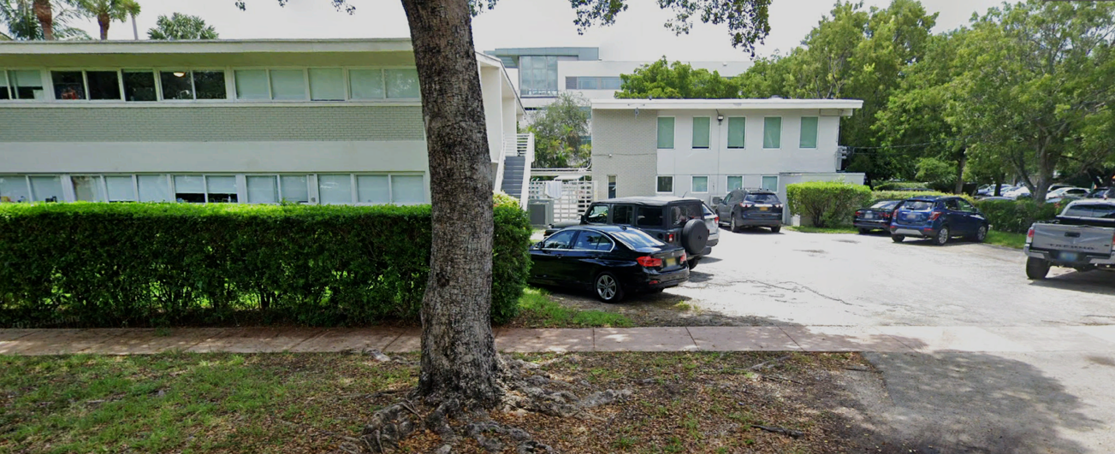
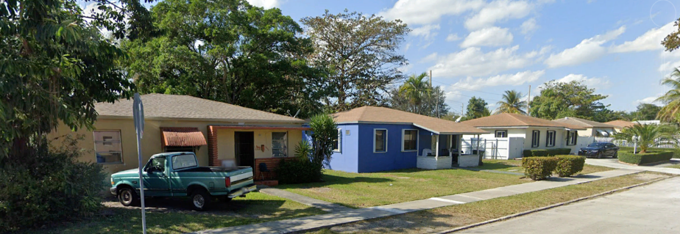
CONTEXT:
North: Hardee Road / Brescia Av., SW 64th Street
Uses 2 single-family homes
FLUM Miami-Dade High-Density Residential
Zoned Miami-Dade RU-1Z & RU-4
Height Permitted 9 stories
South: SW 66th Street
Uses Red Road Commons - 404 living units
FLUM TSD
Zoned PUD-M
Height Permitted 5 stories
East: Red Road, SW 57th Avenue
Uses: University of Miami
Lau Founders Hall, Studio Arts Building
Land Development City of Coral Gales. UM Master Plan
West: SW 57th Court
Uses Ten 1-story, single-family homes
FLUM Single-Family Residential
Zoned RS-4
Height Permitted 2 stories and 25 feet

Slide 4
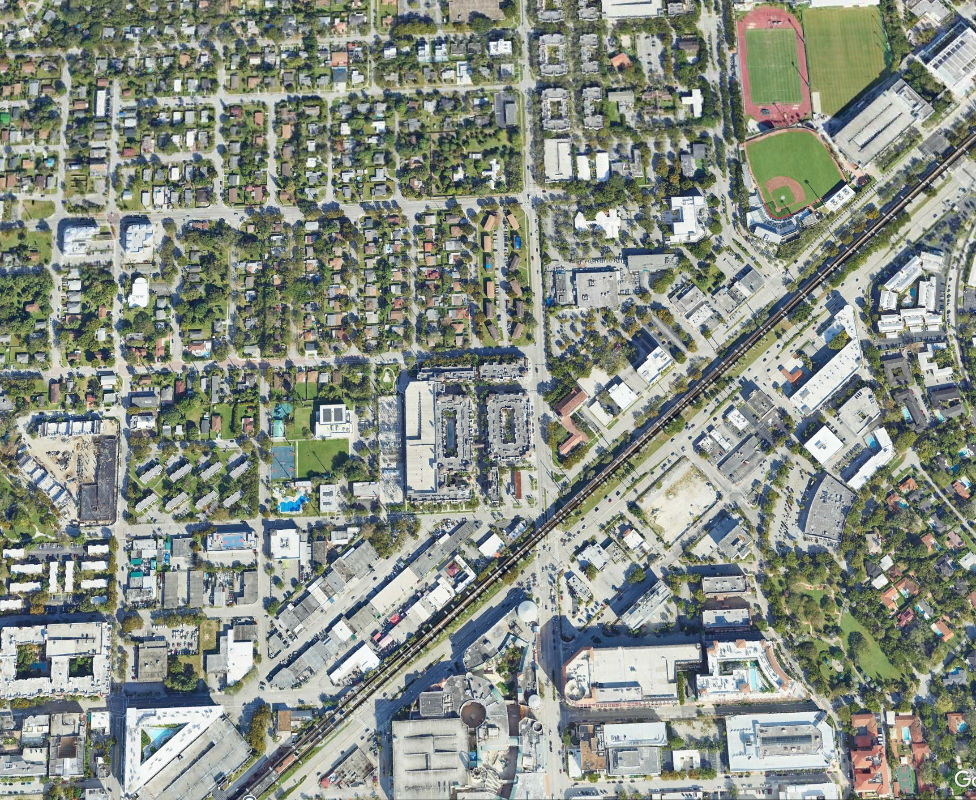
COMPATIBILITY:
Land use is student housing
Permitted use in TSDD Ordinance 28-25-2541
Walking distance to the University of Miami
Walking distance to the South Miami Metrorail Station
Provides density of residences to populate downtown South Miami and support TSDD goals
Transit to work, esp. Miami CBD
  Walk to employment
  Walk to South Miami retail, eateries. and entertainment
Height and transition consistent with TSDD-TSNA zoning code
University of Miami
x
South Miami Downtown
South Miami
Metro Rail Station
South Miami Downtown

Slide 5
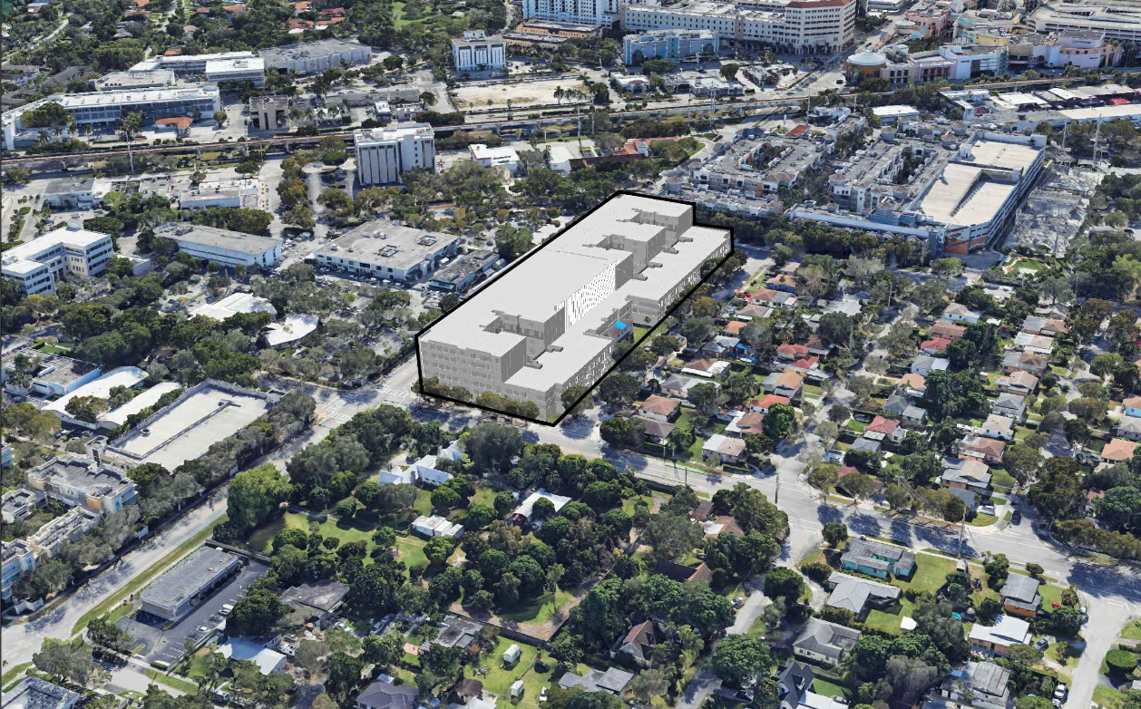
COMPATIBILITY:
Transitions to single family neighborhood to west across SW 57 Ct.
1 story higher that Red Road Commons along Red Road
2 stories lower than Red road along SW 57th Ct.
Building mass relief faces wet and addresses neighborhood to west
Open space plaza provides ground level relief along SW 57th Ct.

Slide 6
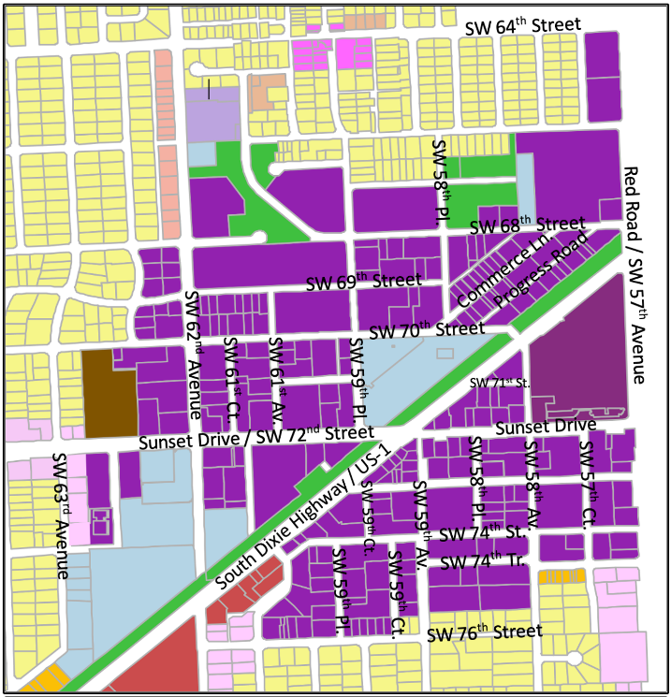
CONSISTENCY with TSD
Comprehensive Plan
Subject site
Supports and is consistent with Future Land Use Policy
FLU Policy 1.1.1
FLU Policy 1.1.3
FLU Policy 1.1.4
FLU Policy 1.1.6
FLU Policy 1.1.7
FLU Policy 1.3.1
FLU Policy 1.4.1
FLU Policy 1.5.1
FLU Policy 1.6.1

Slide 7
CONSISTENCY with TSDD
§20-8.3, 4, 5 Subdistricts, Uses - Residential Density
 | Permitted | Proposed
Parcel Area | 5,000 sq. ft. min. | 2.73 acres
Sub District | TSNA | TSNA
Use | Multi-family Residential Off-Campus Student Apartments Accessory commercial to student apartments | Off-Campus Student Apartments Coffee Café (1,455 sq. ft.)
Density | 100 as-of-right | 88 DU/acre
Bedroom Size | 150 sq. ft. per bedroom | 153 sq. ft. to 215 sq. ft.
Residential Units | 273 residential units 956 student bedrooms | 240 units 772 bedrooms

Slide 8
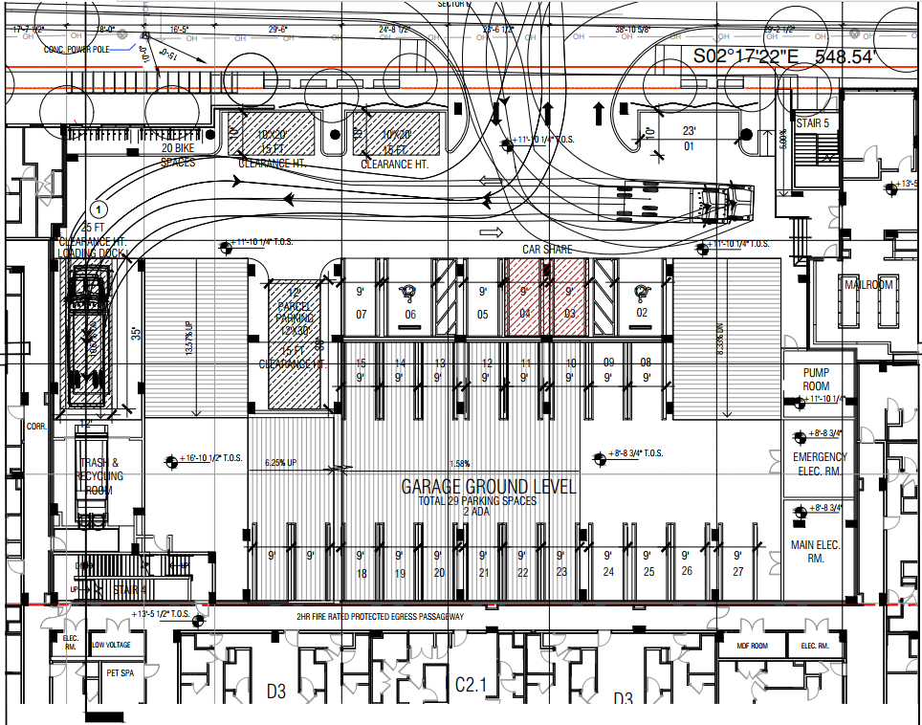
CONSISTENCY with TSDD
§20-8.6 Parking & Loading
 | Required | Proposed
Internal Parking | 384 | 395
Street Parking | 0 | 0
Delivery: Small Berth Medium Berth | 1 1 | 1 1
Car Sharing | 2 | 2
Internal Bicycle | 193 | 16
Outdoor Bicycle (on-site) | 193 | 16
DELIVERY
LOADING
LOBBY
CAR
SHARE
PARCEL
TRASH
PICK-UP

Slide 9
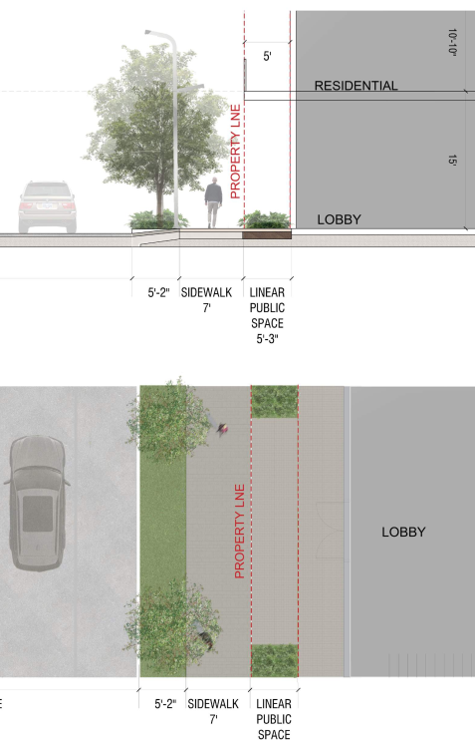
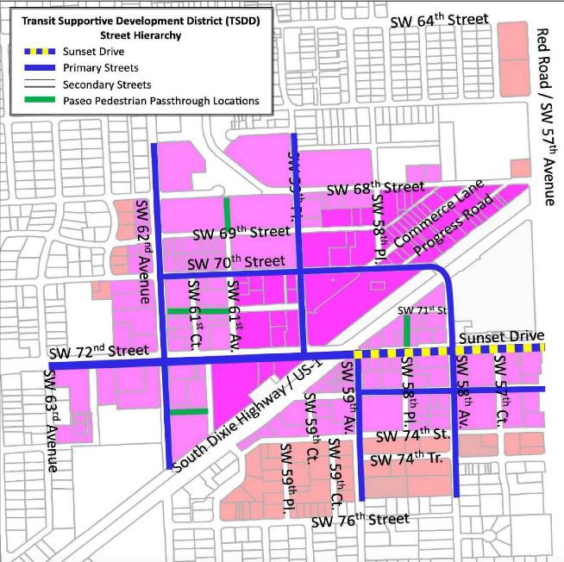
CONSISTENCY with TSDD
§20-8.9(A) Street Hierarchy
Orientation – fronts primary street, Red Road
Build-to line: 5 ft. from property line on all sides
No dedications – easement on Red Road
Sidewalk landscape zone: 4 ft. on all sides
Clear Pedestrian Path:
                7 ft. on Red Road
                6 ft. other three sides

Slide 10
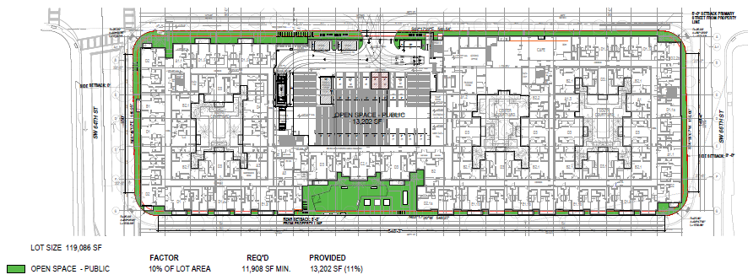
CONSISTENCY with TSDD
§20-8.9(B) Open Space
        Linear open Space + Plaza
        10% of lot area required, 11% provided

Slide 11
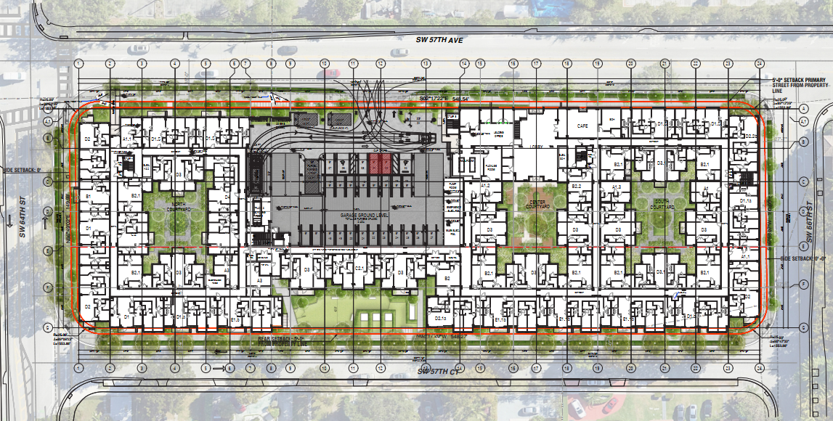
CONSISTENCY with TSDD
§20-8.9(B) Landscape
public / ground-level landscape shown - additional landscaping on Level 4 roof facing west
total Street trees = 73 shade trees site trees = 25 shade trees, 68 palm trees

Slide 12
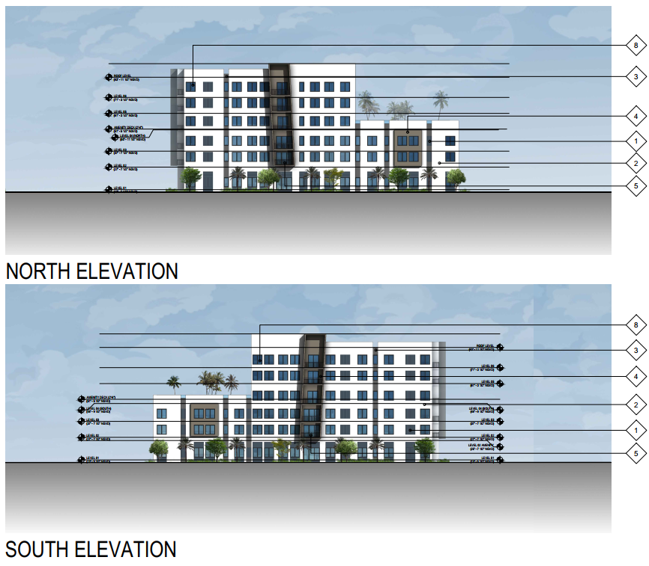
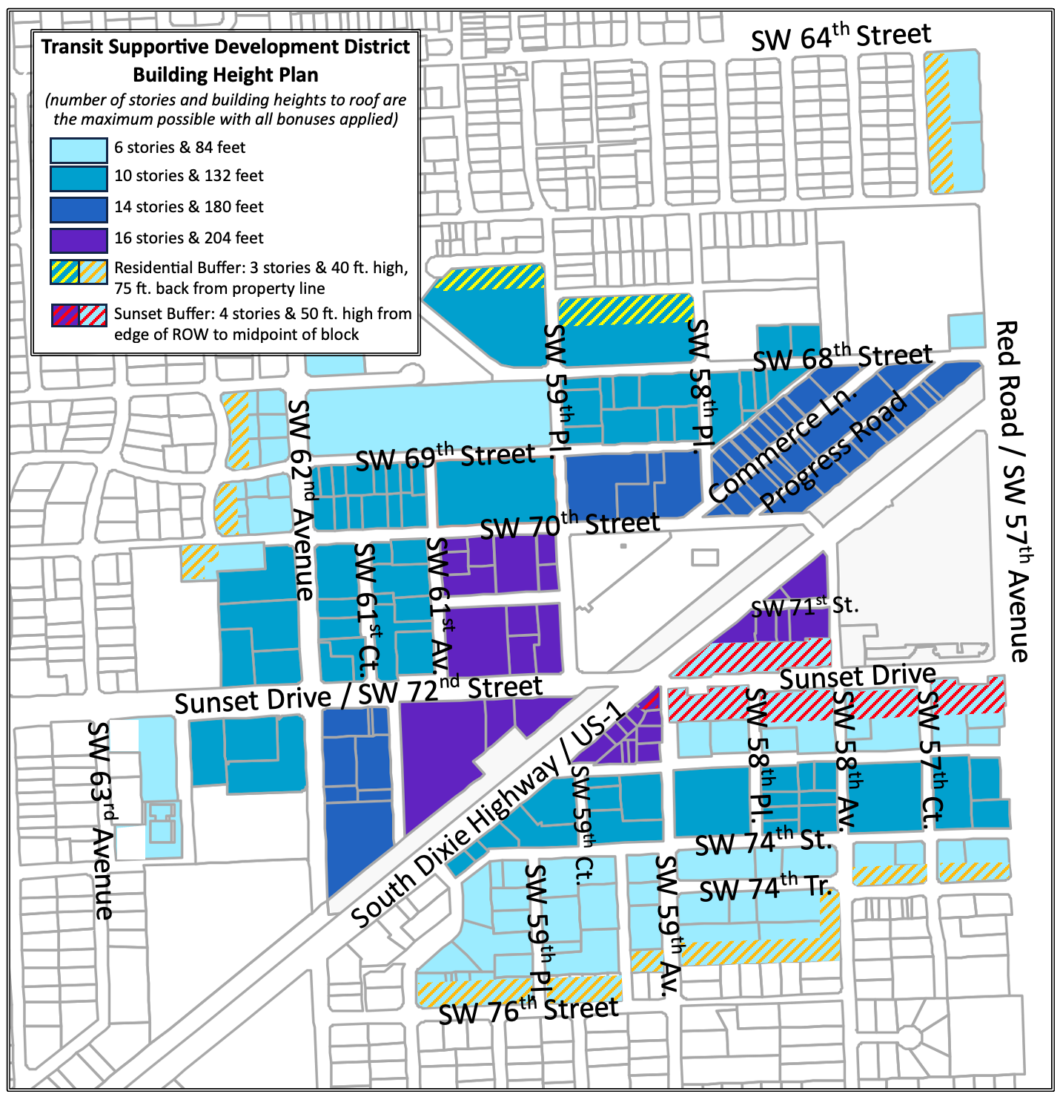
CONSISTENCY w/ TSDD
§20-8.9(C) Building Height
 | Maximum | Maximum | Proposed
Front of Building
Stories |  | 6 | 6
Roof Height |  | 84 ft. | 72’-1 ½“
Total Height |  | 94 ft | 80’-4 ½“
Transition Zone: 75 horizontal feet facing single-family
Stories |  | 3 | 3
Roof Height |  | 40 ft. | 39’-7 ½“
Total Height |  | - | 40’-5 ½“

Slide 13
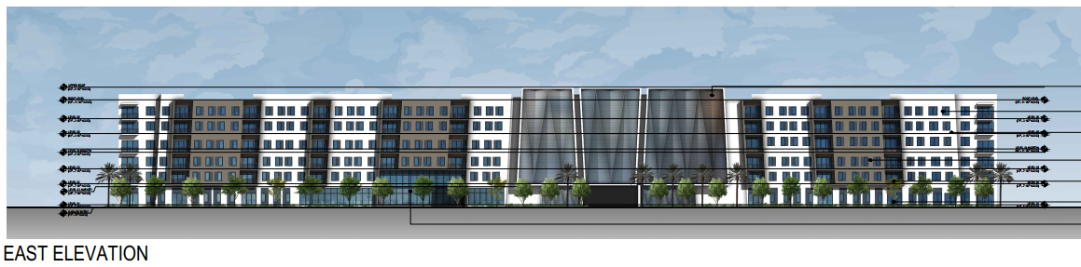
CONSISTENCY with TSDD
§20-8.9(D) Building Location, Massing, Form
pages 26 – 27 of staff report
building coverage is consistent: 80% permitted; 79.6% provided
building frontage of all block faces meets requirement for each
floorplates above 4th floor are not consistent
build-to, setbacks, horizontal building variation, and depth of variation meet criteria
floor plate above 4th floor does not meet criteria – applicant applied for variance

Slide 14
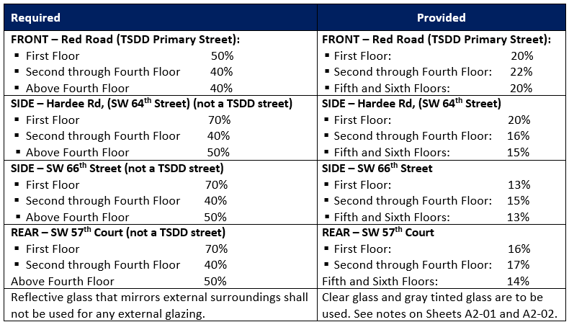
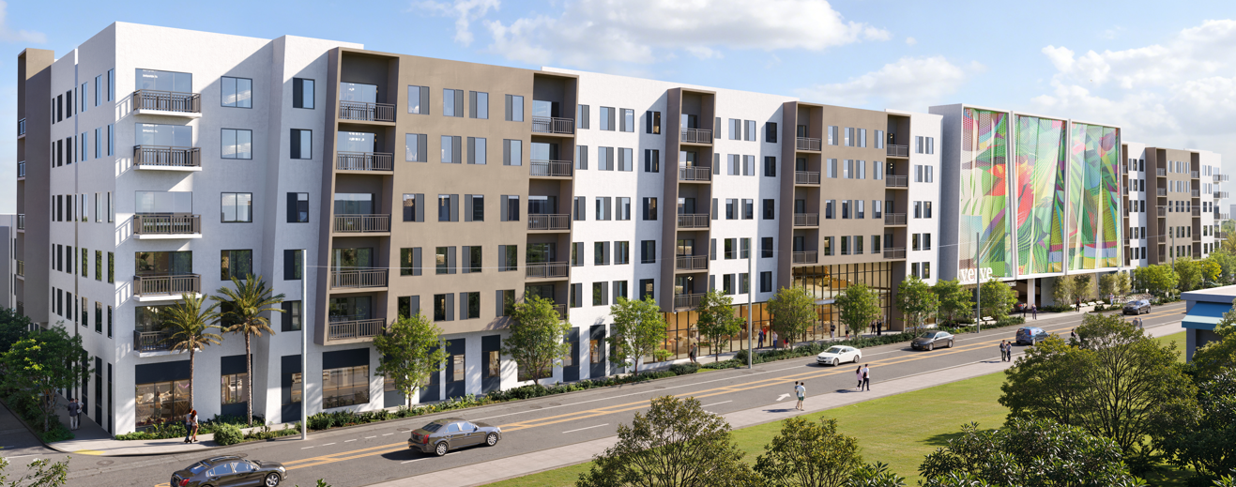
CONSISTENCY with TSDD
§20-8.10 Architectural Standards
LEED Silver certification attainment
window glazing meets requirements
garage screening will apply to AIPP

Slide 15
VARIANCE
Five Criteria to be found in affirmative – Section 20-5.9(H)
Variance is necessary to relieve particular, extraordinary conditions relating to property
Denial of variance results in hardship to the owner
Extraordinary conditions not resulting from actions of owner
Request is the minimum necessary to make possible, reasonable use of property.
Approval of variance is not inconsistent with the general intent of LDC and not injurious to the general welfare of the neighborhood

Slide 16
VARIANCE
1. Variance is necessary to relieve particular extraordinary conditions relating to property
  transition area limitation from 75-foot transition: Level 4, 5, 6 are 125 feet deep
  garage limited to have access away from single-family use
  garage is located on Red Road in the middle of the project to reduce neighborhood traffic intrusion
  linear organization of building: garage needs to connect at each floor

Slide 17
VARIANCE
2. Denial of the variance would result in hardship to the owner.
Hardship results if the restriction of the zoning ordinance when applied to a particular property becomes arbitrary, confiscatory, or unduly oppressive because the conditions that distinguish it from other properties under similar zoning restrictions.
Transition restriction applies here and only transition areas
Floor Plate restriction applies here and all of TSDD

Slide 18
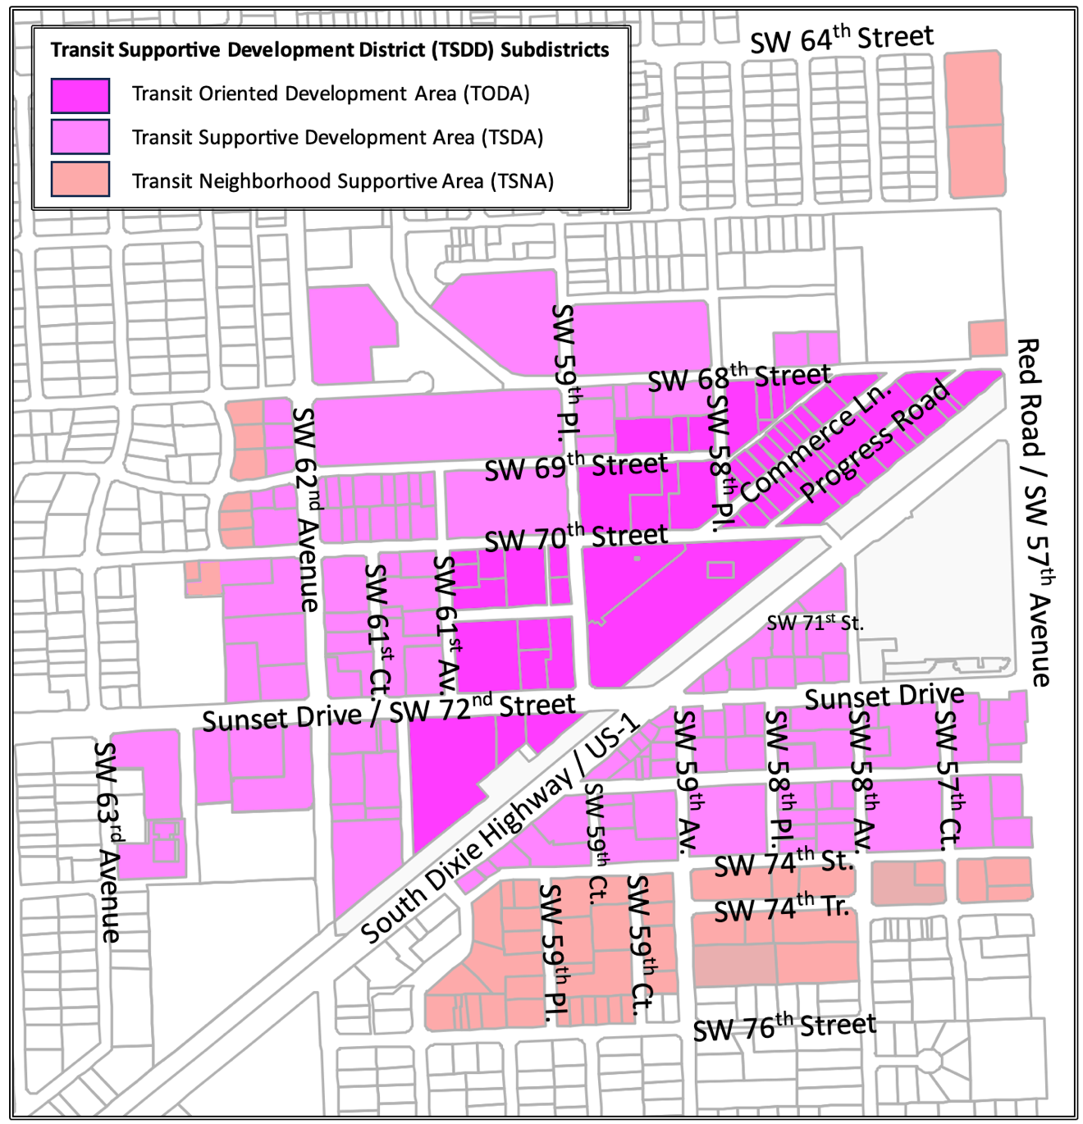
VARIANCE
Extraordinary conditions and circumstances are not the result of the owner’s action
  a garage attached to residences at each level is normal and safe
  design reacts to the need to reduce neighborhood traffic intrusion
  and locate garage access away from intersections
  relief would be possible if the use were different
  conditions result from inherent requirements of TSDD code that in combination cause extraordinary conditions that although not unique, are extraordinary.

Slide 19
VARIANCE
4. Request is the minimum necessary to make possible, reasonable use of property.
  variance for 5th and 6th floor is no greater than the floor area of the 4th floor
  no other design relief is requested
  all other aspects of proposal meet TSDD regulations
5. Approval of variance will not be inconsistent with the general intent and purpose of the land development code and will not be injurious or detrimental to the public welfare
  request does not create unsafe conditions
  improves safety and security of internal circulation
  does not result in separation of building masses for a regulation that was intended to control tower mass for the rest of the TSDD
  Commission discussion has directed staff to include changes to regulations that would, if adopted, negate the need for this variance request.

Slide 20
STAFF RECOMMENDATIONS
Recommend for approval of the Large-Scale Special Exception
Recommend acceptance of the requested variance for building coverage on the 5th and 6th floors

