Slide 1


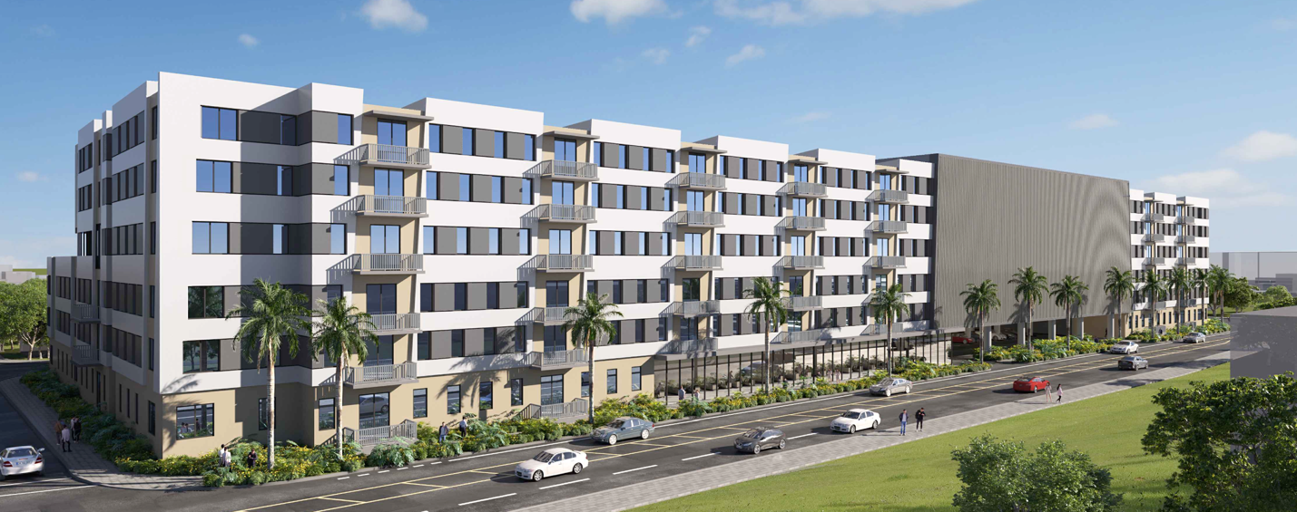
Dvisory B
Design Review Board January 6, 2026
PAB # 2026-02
Large-Scale Development
Special Exception
Site Plan Review

Slide 2
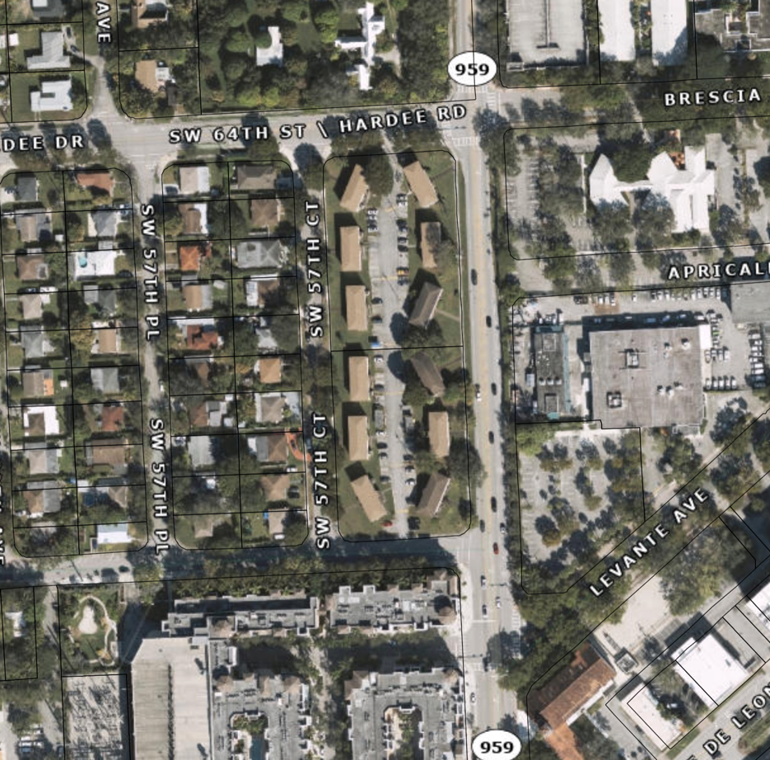
LOCATION:
6404 & 6504 Red Road
full block:
east of Red Road
east of SW 57th Court
north of SW 66the Steet
south of SW 64th Street
2.73 acres, 119,086 sq. ft.
Existing Use: 48 apartments
RM-18
FLUM Designation: TSD
Zoning Designation: TSDD
TSDD Sub-Zone: TSNA
x

Slide 3
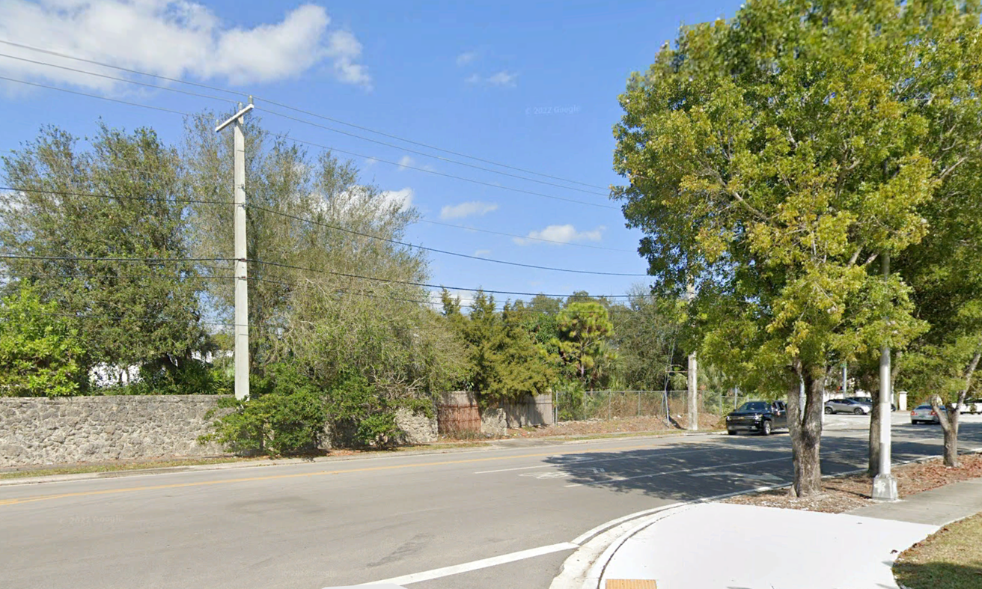
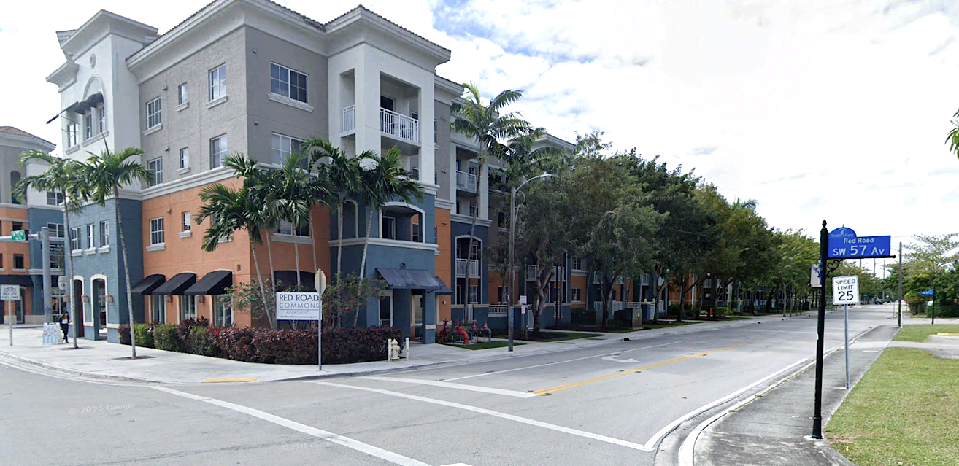
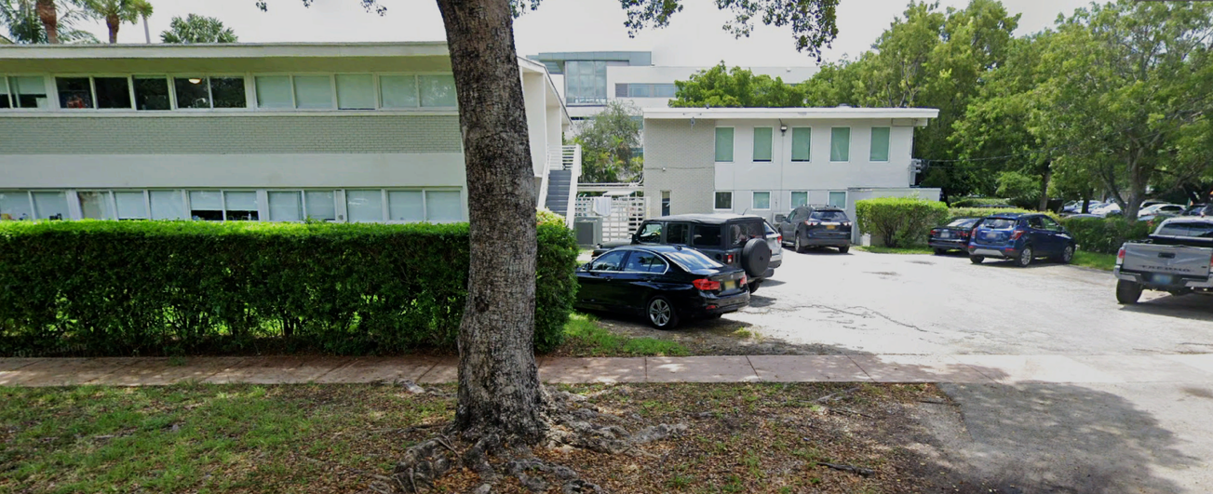
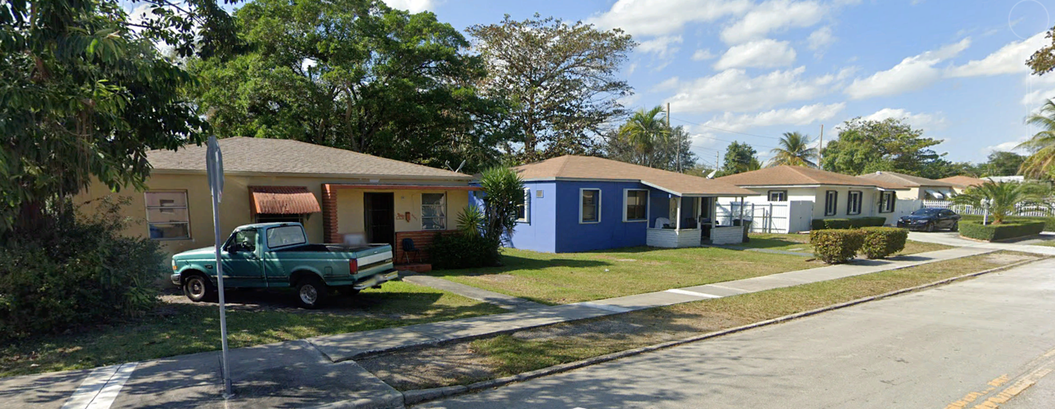
CONTEXT:
North: Hardee Road / Brescia Av., SW 64th Street
Uses 2 single-family homes
FLUM Miami-Dade High-Density Residential
Zoned Miami-Dade RU-1Z & RU-4
Height Permitted 9 stories
South: SW 66th Street
Uses Red Road Commons - 404 living units
FLUM TSD
Zoned PUD-M
Height Permitted 5 stories
East: Red Road, SW 57th Avenue
Uses: University of Miami
Lau Founders Hall, Studio Arts Building
Land Development City of Coral Gales. UM Master Plan
West: SW 57th Court
Uses Ten 1-story, single-family homes
FLUM Single-Family Residential
Zoned RS-4
Height Permitted 2 stories and 25 feet

Slide 4
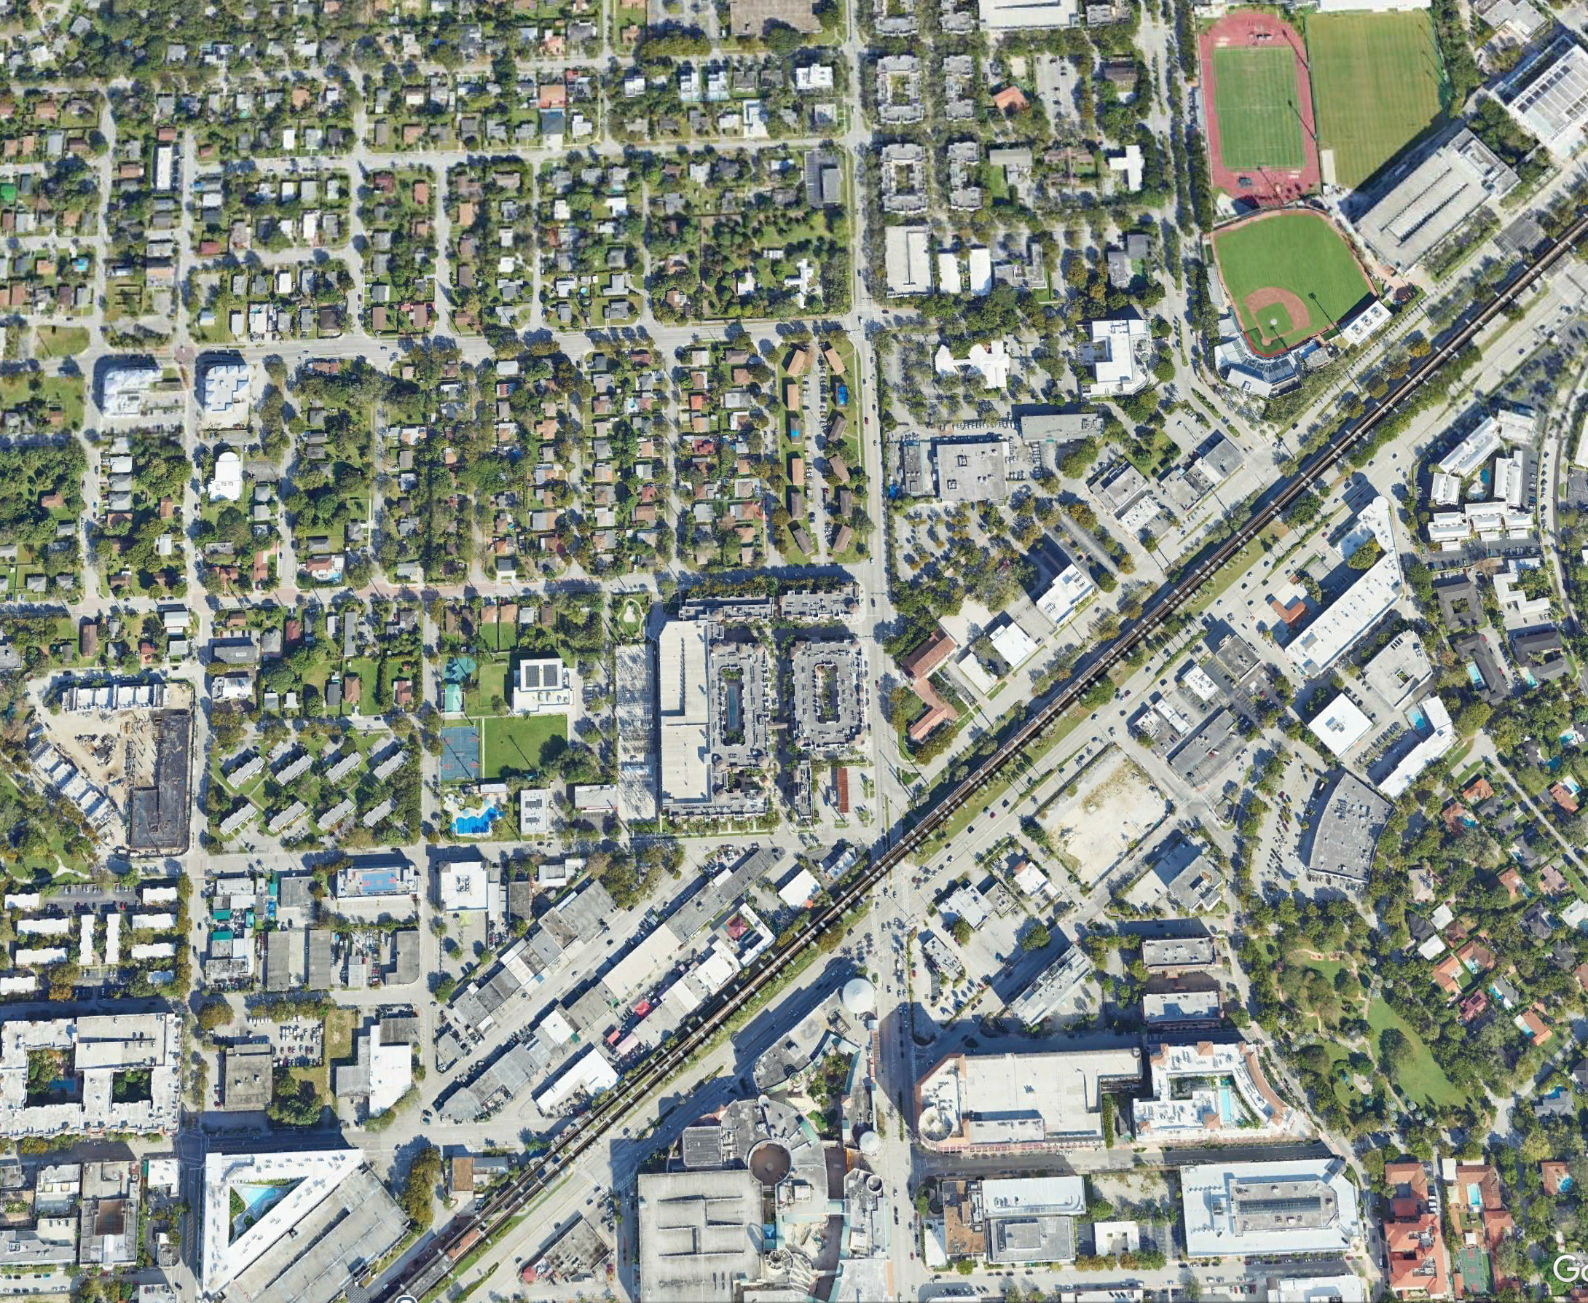
COMPATIBILITY:
Land use is student housing
Permitted use in TSDD Ordinance 28-25-2541
Walking distance to the University of Miami
Walking distance to the South Miami Metrorail Station
Provides density of residences to populate downtown South Miami and support TSDD goals
Transit to work, esp. Miami CBD
  Walk to employment
  Walk to South Miami retail, eateries. and entertainment
Height and transition consistent with TSDD-TSNA zoning code
University of Miami
x
South Miami Downtown
South Miami
Metro Rail Station
South Miami Downtown

Slide 5
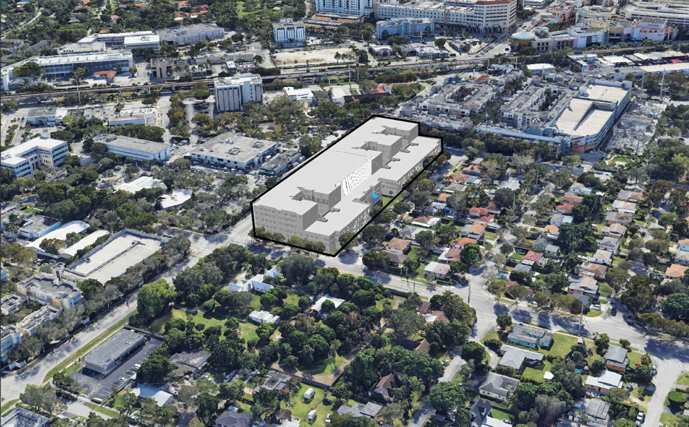
COMPATIBILITY:
Transitions to single family neighborhood to west across SW 57 Ct.
1 story higher that Red Road Commons along Red Road
2 stories lower than Red road along SW 57th Ct.
Building mass relief faces wet and addresses neighborhood to west
Open space plaza provides ground level relief along SW 57th Ct.

Slide 6
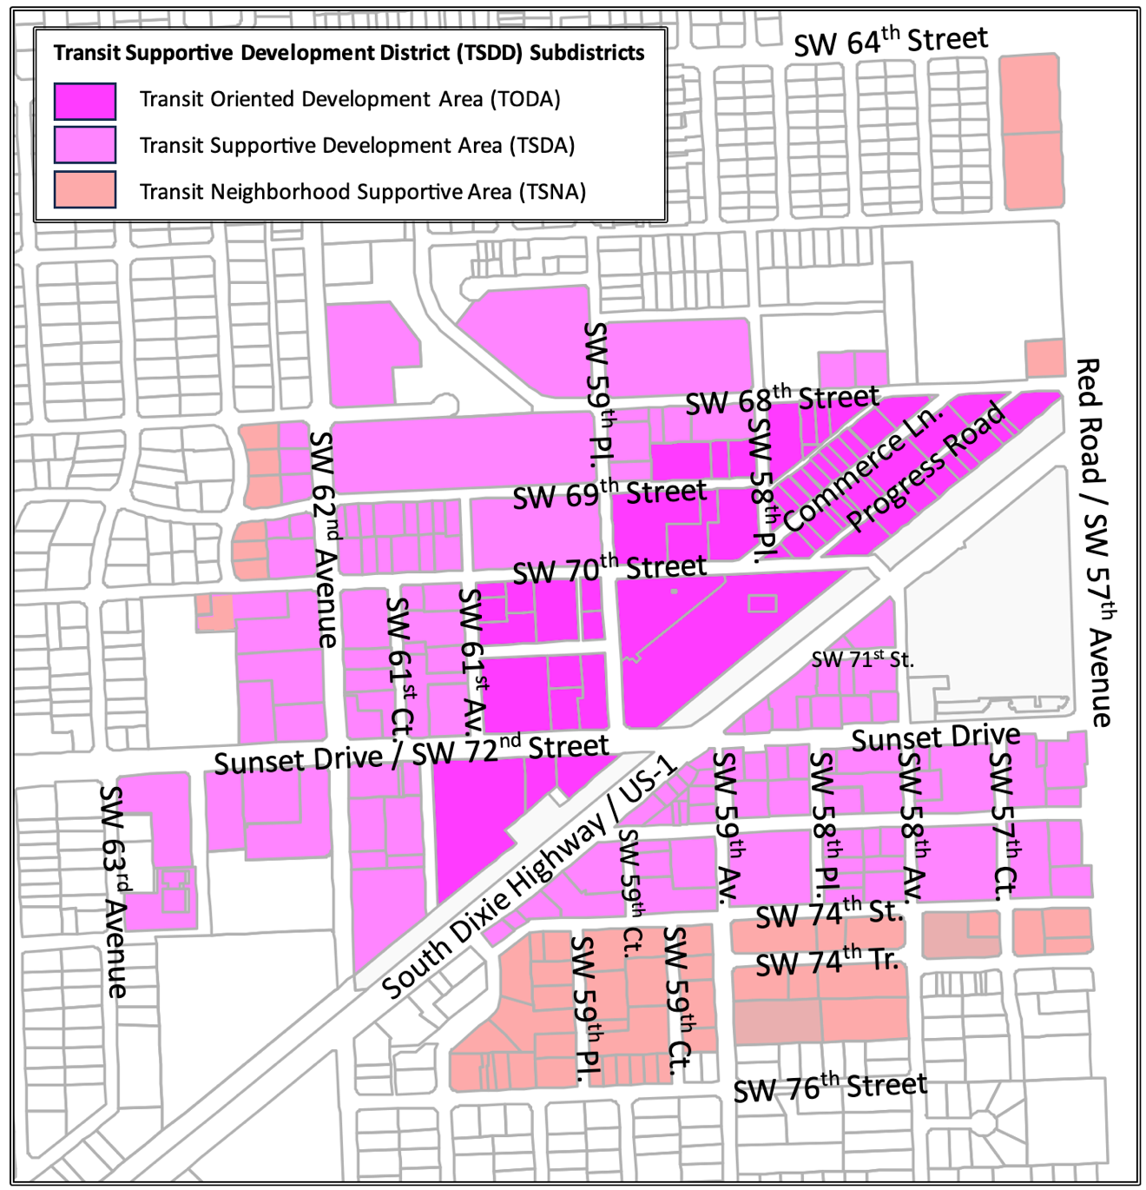
CONSISTENCY with TSDD
§20-8.3, 4, 5 Subdistricts, Uses, Residential Density
Subject site
 | Permitted | Proposed
Parcel Area | 5,000 sq. ft. min. | 2.73 acres
Sub District | TSNA | TSNA
Use | Multi-family Residential Off-Campus Student Apartments Accessory commercial to student apartments | Off-Campus Student Apartments Coffee Café (1,172 sq, ft,)
Density | 100 as-of-right | 79 DU/acre
Bedroom Size | 150 sq. ft. per bedroom | - - - - - -
Residential Units | 273 residential units 956 student bedrooms | 263 units 754 bedrooms

Slide 7
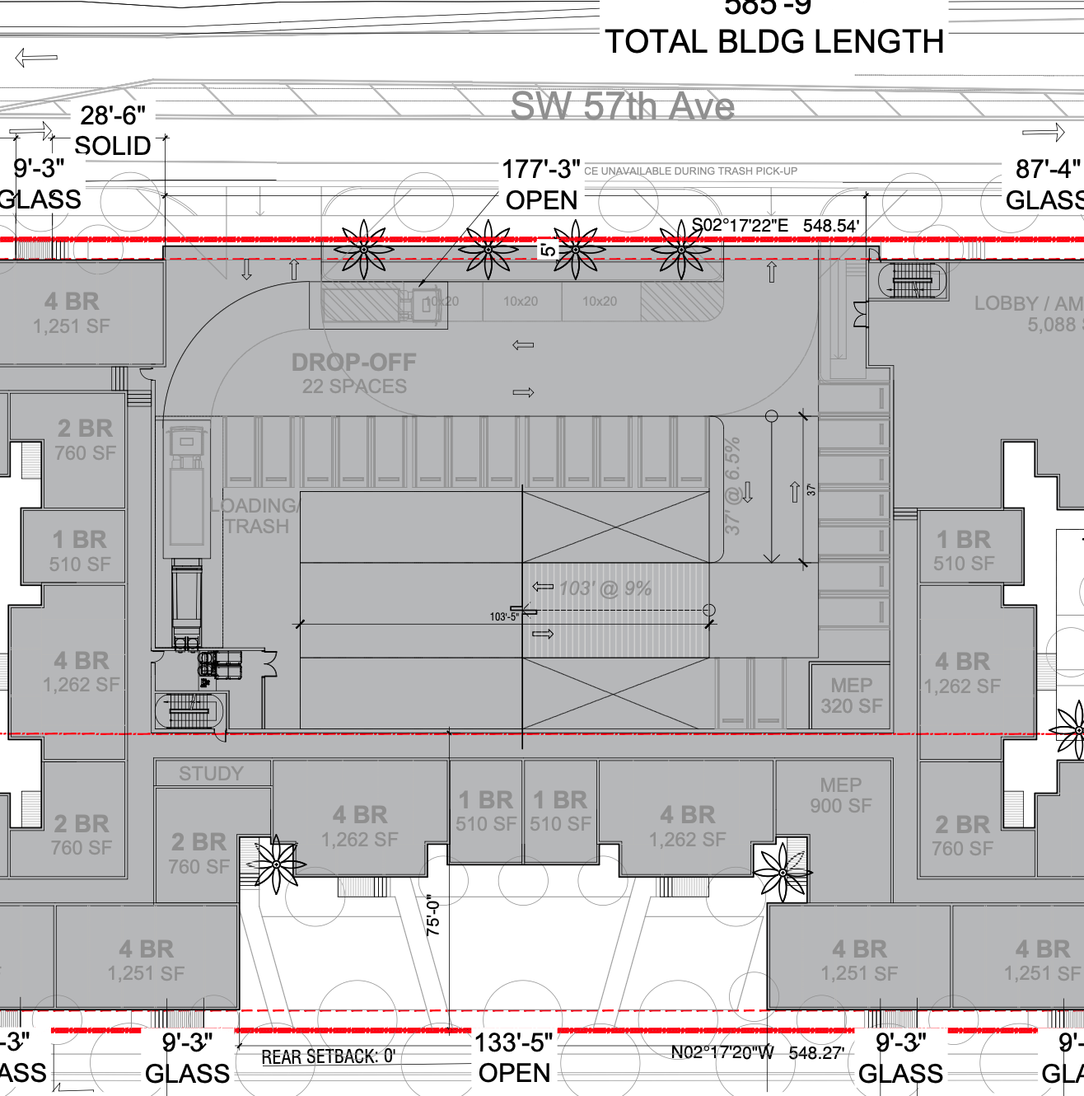
CONSISTENCY with TSDD
§20-8.6 Parking & Loading
Parking is sufficient
Loading is not sufficient
Car sharing
Bicycle storage not sufficient
DELIVERY?
CAR SHARE
 | Required | Proposed
Internal Parking | 382 | 428
Street Parking | 0 | 0
Delivery | 2 small berths 1 medium berth | 0
Car Sharing | 2 | 2
Internal Bicycle Storage | 189 | 28
External Bike Racks | 1 | 0
LOBBY
LOADING ?
TRASH
PICK-UP

Slide 8
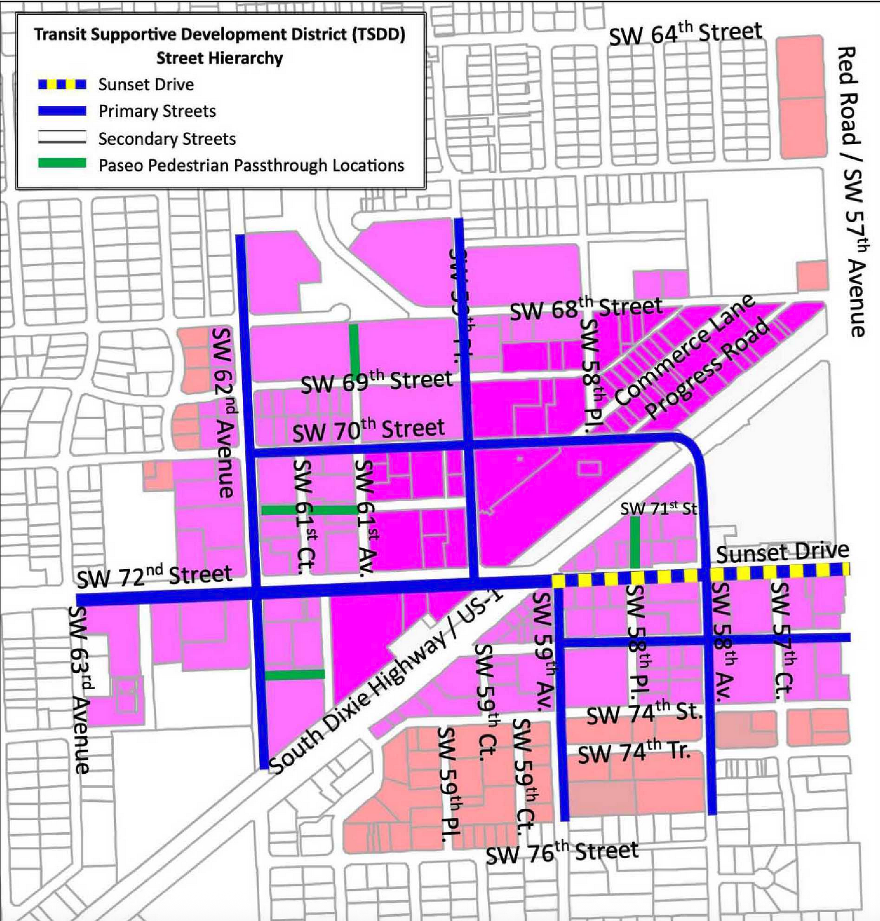
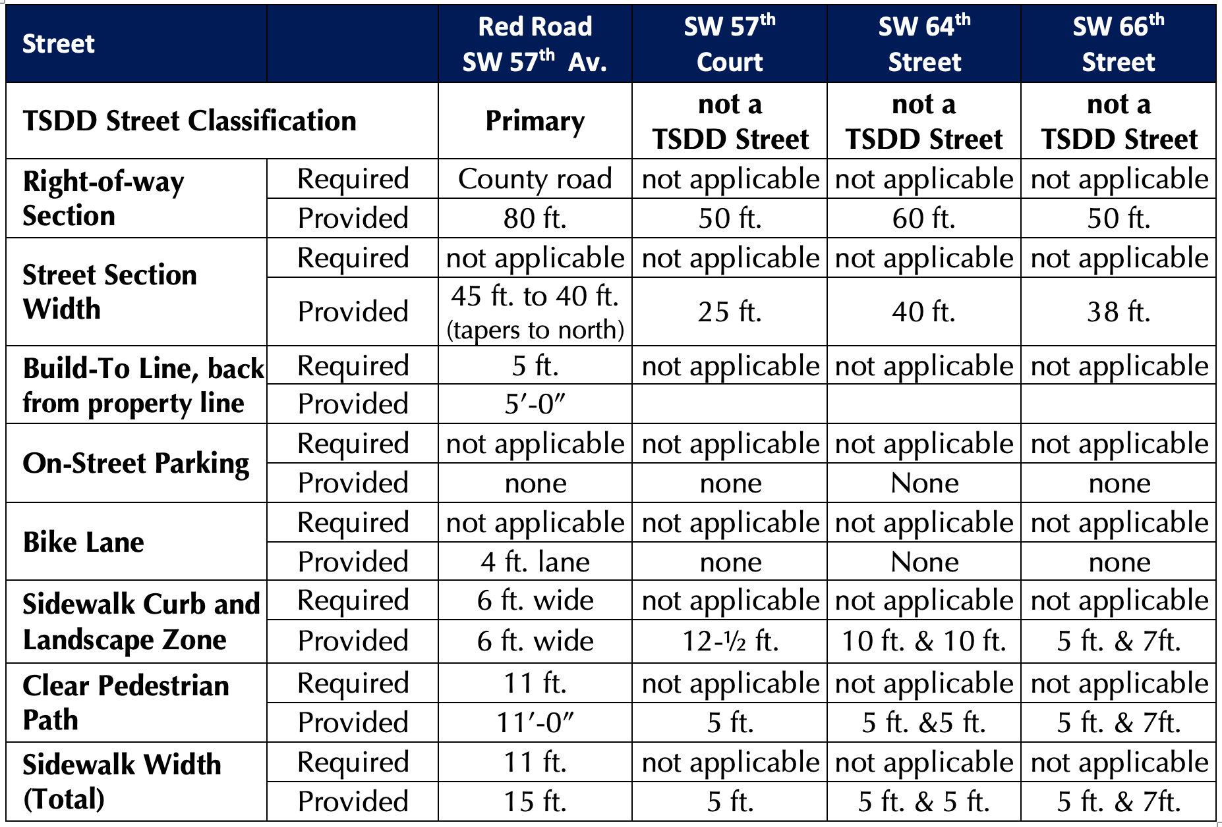
CONSISTENCY with TSDD
§20-8.9(A) Street Hierarchy
Location is at the edge of the South Miami downtown – the Primary Street is Red Road (SW 57th Avenue)
Proposal fronts on Red Road (SW 57th Avenue) - orientation meets the TSDD intent to front on most major roadway
Sidewalk configurations and widths are acceptable
Subject site

Slide 9
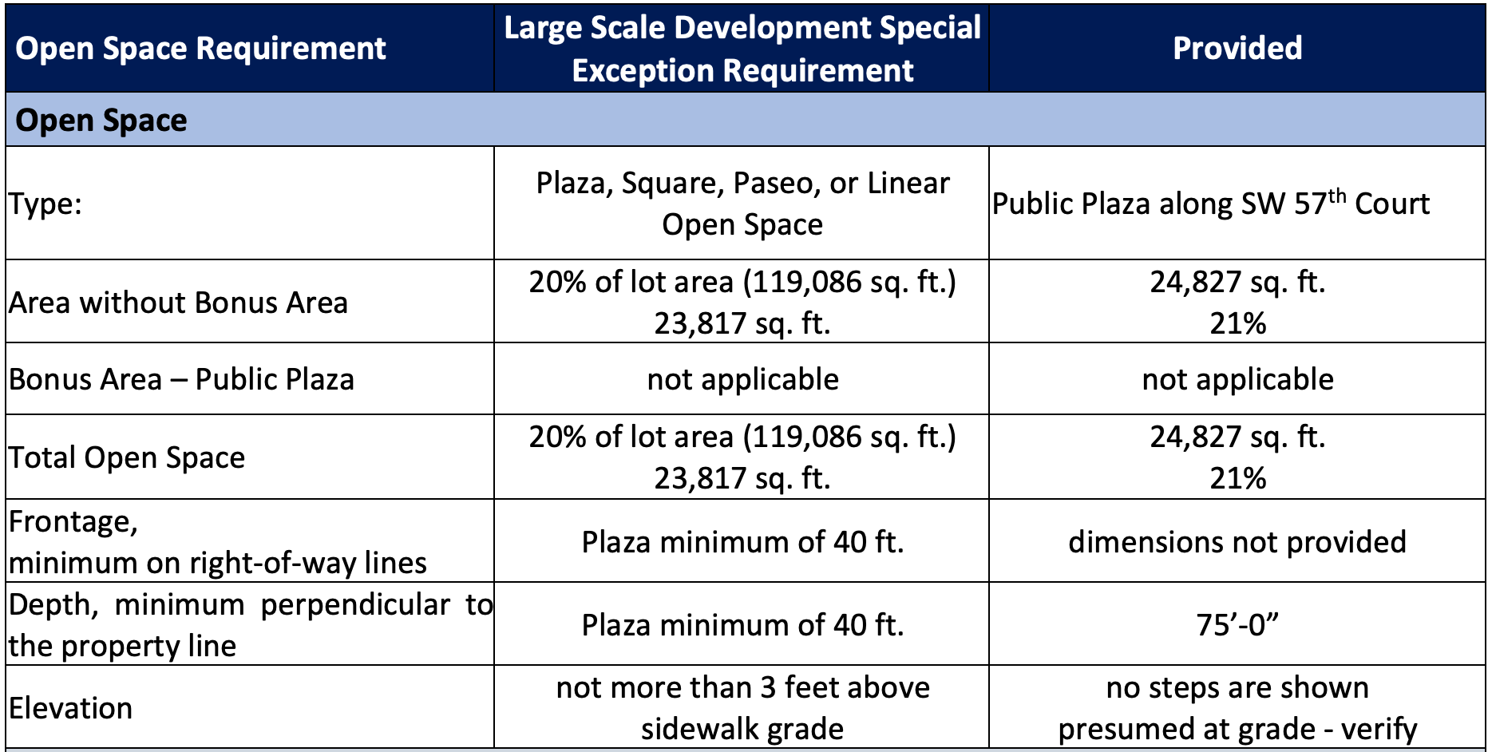
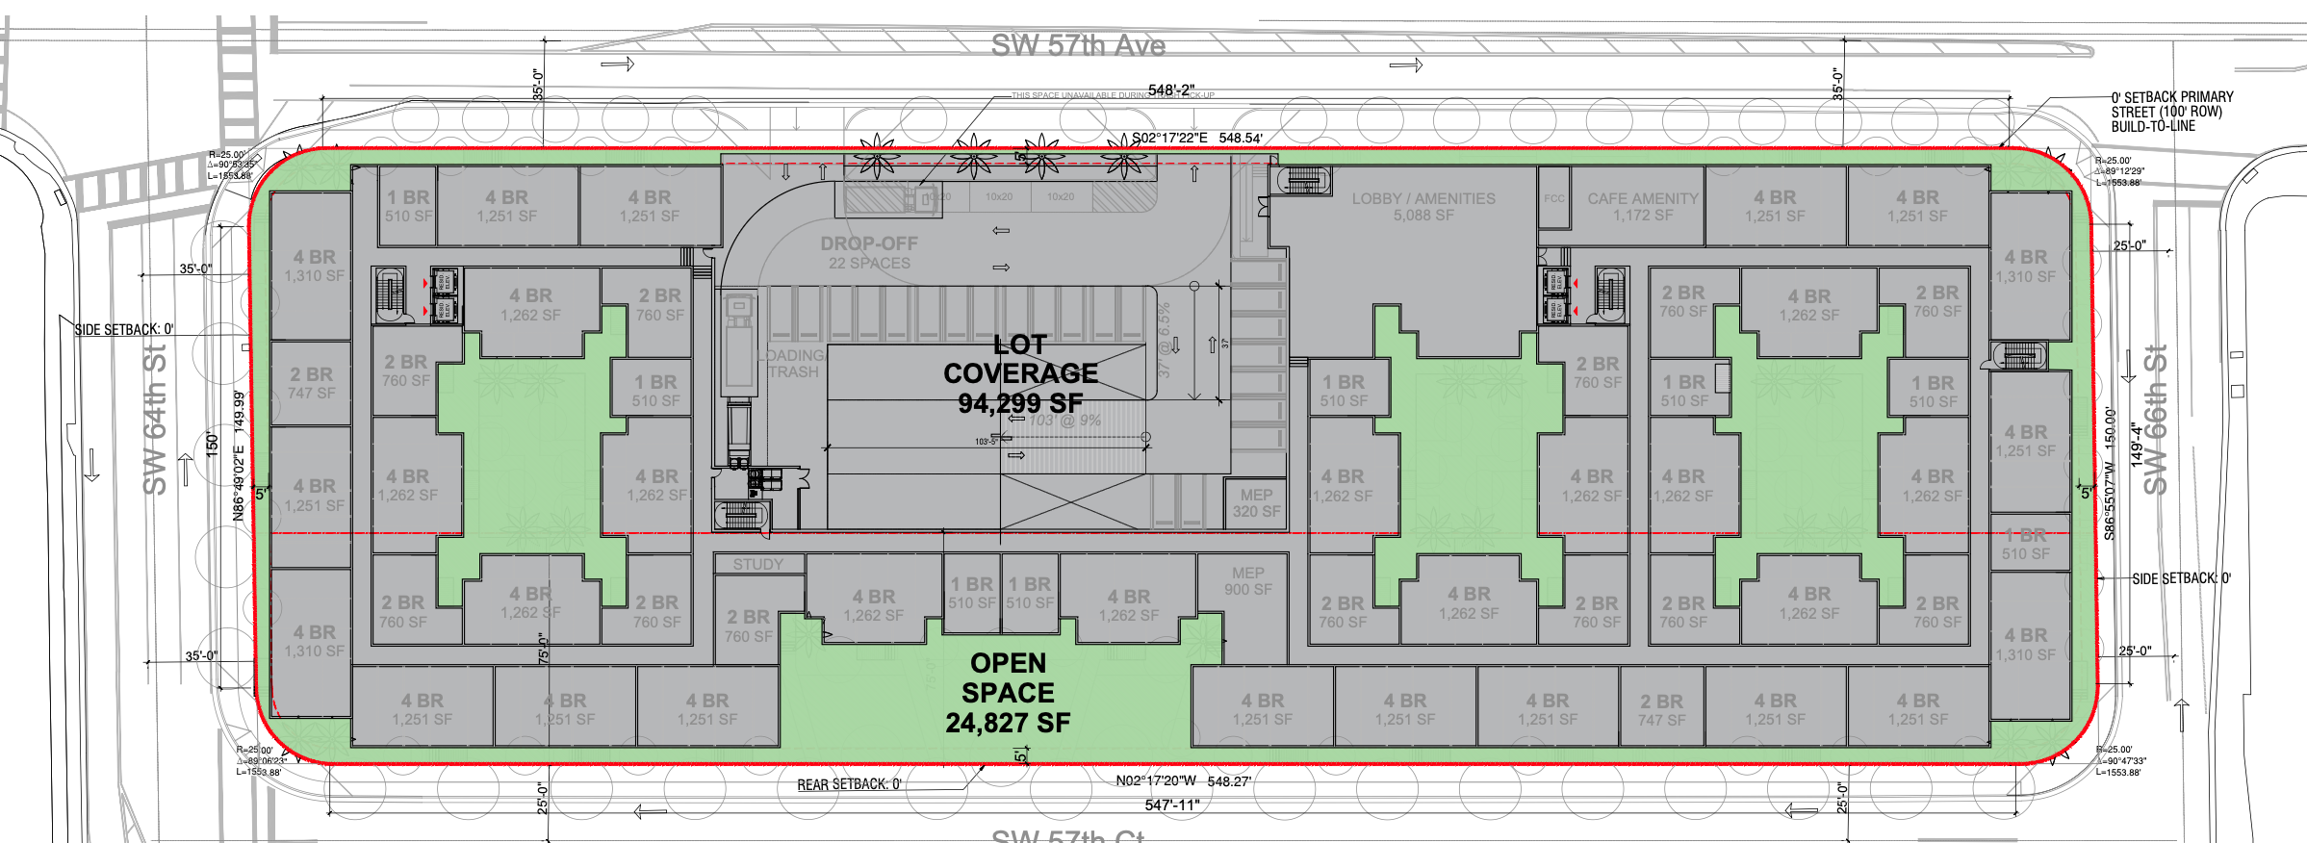
CONSISTENCY with TSDD
§20-8.9(B) Open Space
Linear open Space + Plaza
20% of lot area required, 21% provided
Modifications to be provided by applicant

Slide 10
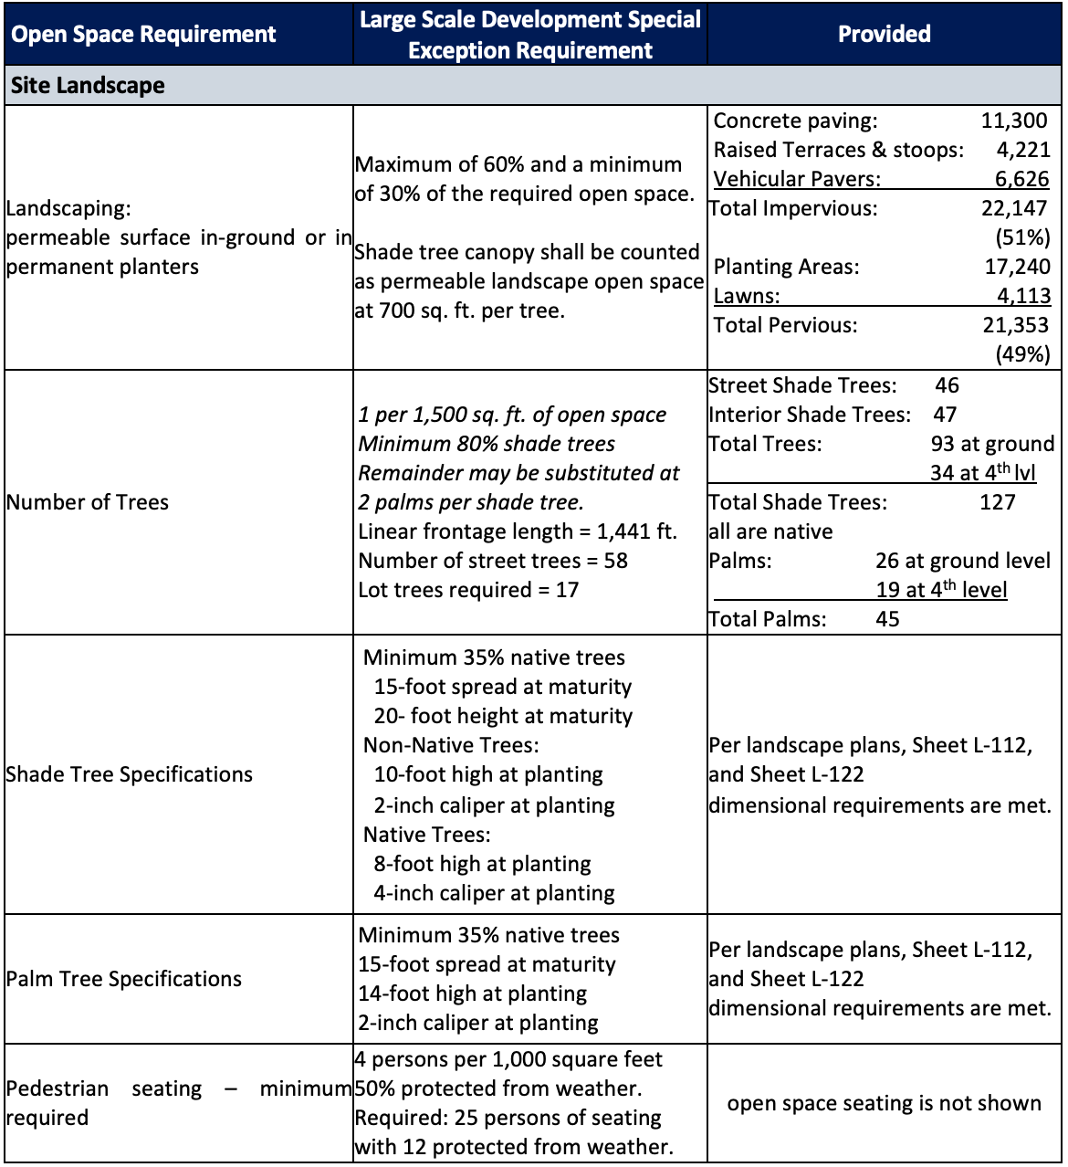
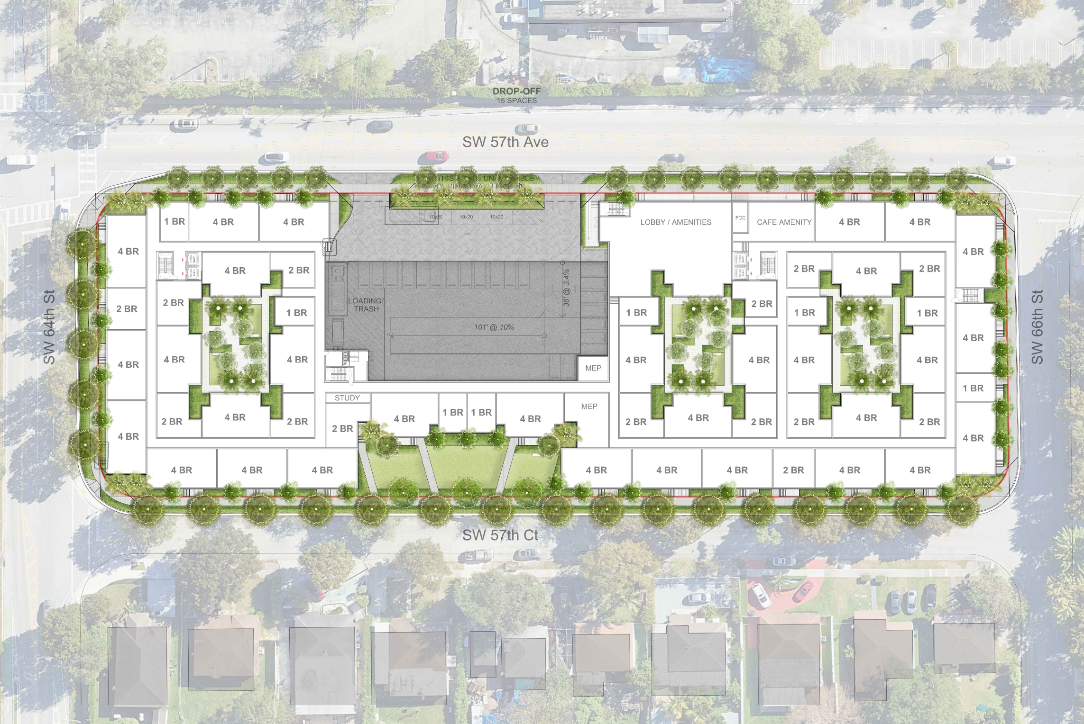
CONSISTENCY with TSDD
§20-8.9(B) Landscape
public / ground-level landscape shown
Additional landscape on roof on Level 4 facing west

Slide 11
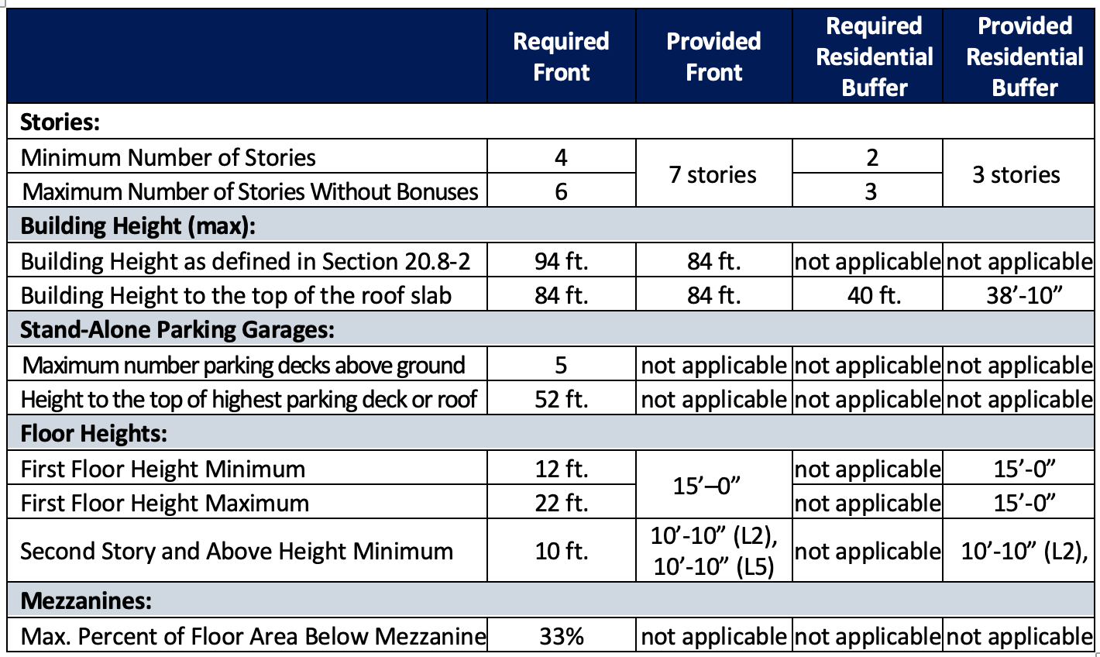
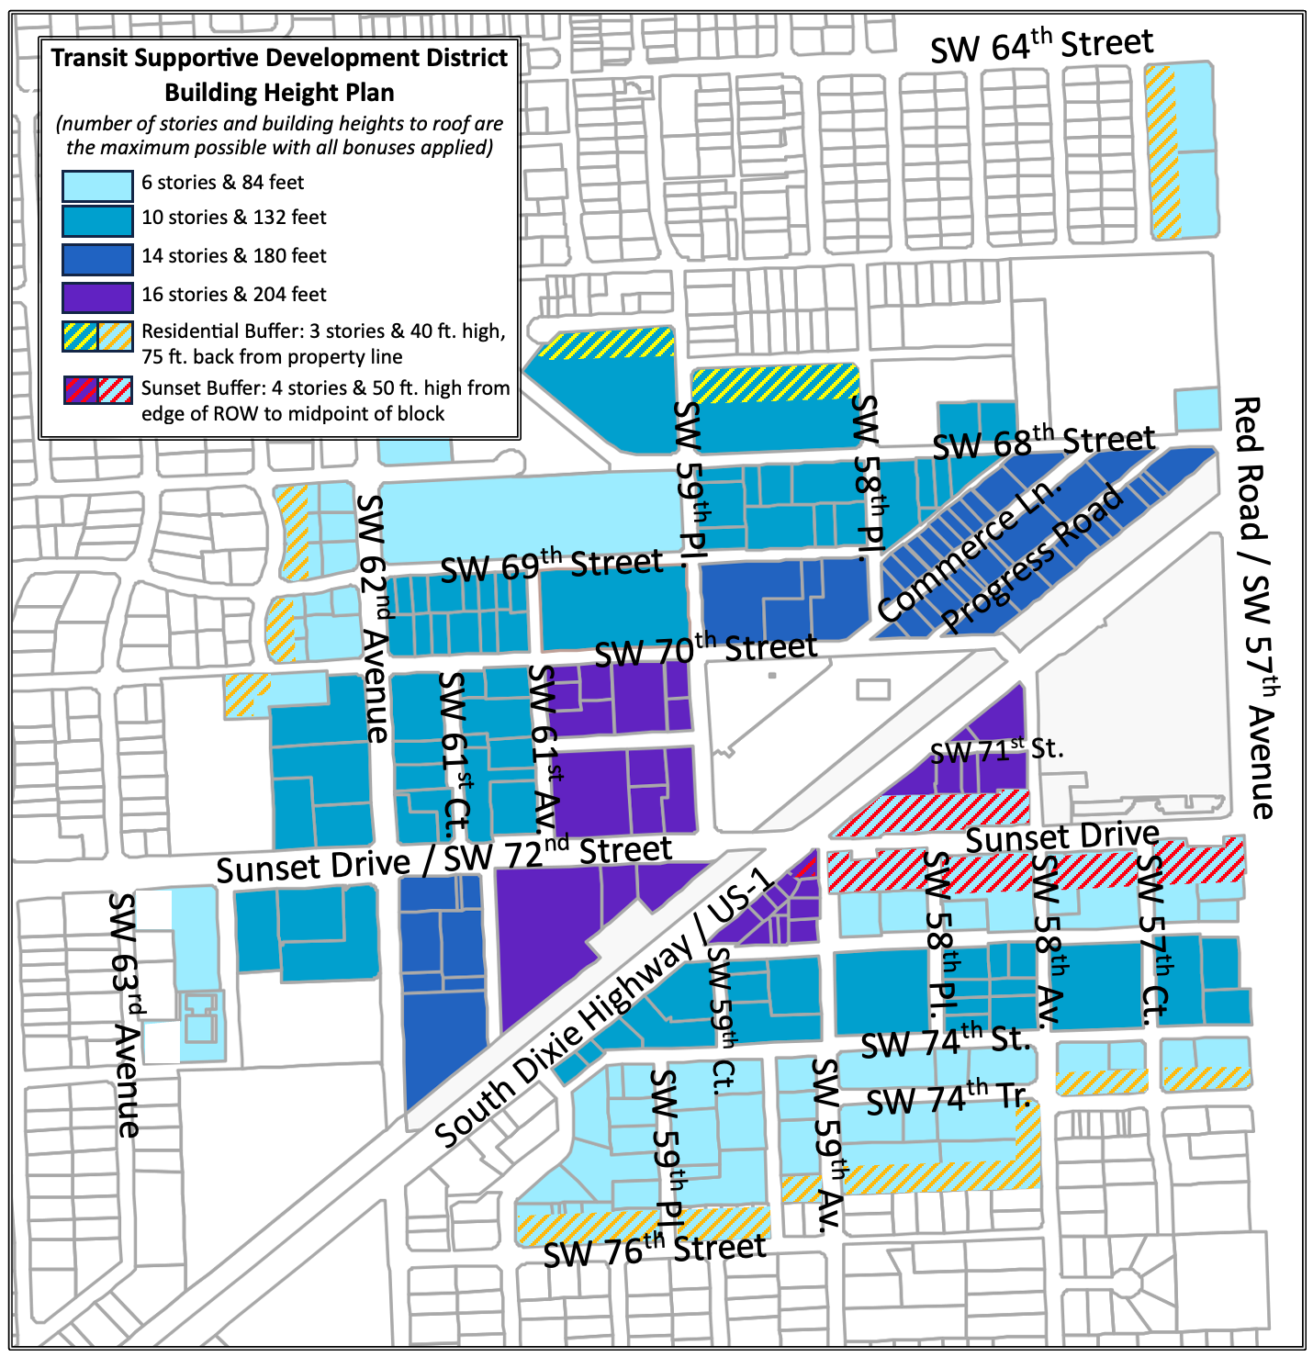
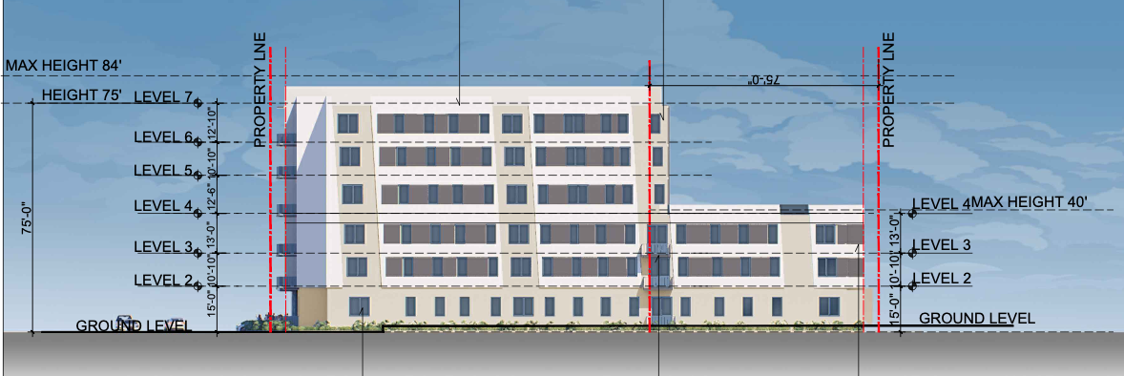
CONSISTENCY w/ TSDD
§20-8.9(C) Building Height
Building height is consistent
Levels 6 habitable levels, 7 for garage
total height is

Slide 12
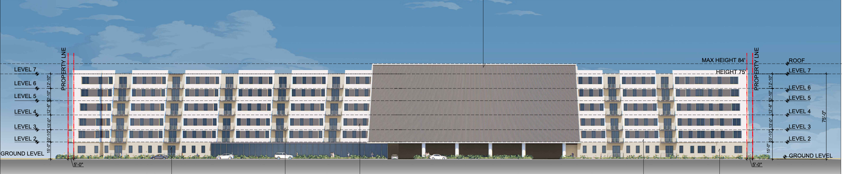
CONSISTENCY with TSDD
§20-8.9(D) Building Location, Massing, Form
Pages 26 – 27 of staff report
Façade frontage occupations are acceptable
Building coverage is consistent: 79% provided, 80% permitted
Require additional dimensions for façade variegation and spacing
Floorplates above 4th floor are not consistent
7th level to be clarified as a roof – Sheet A0-10 to be corrected
Applicant to provide additional massing management

Slide 13
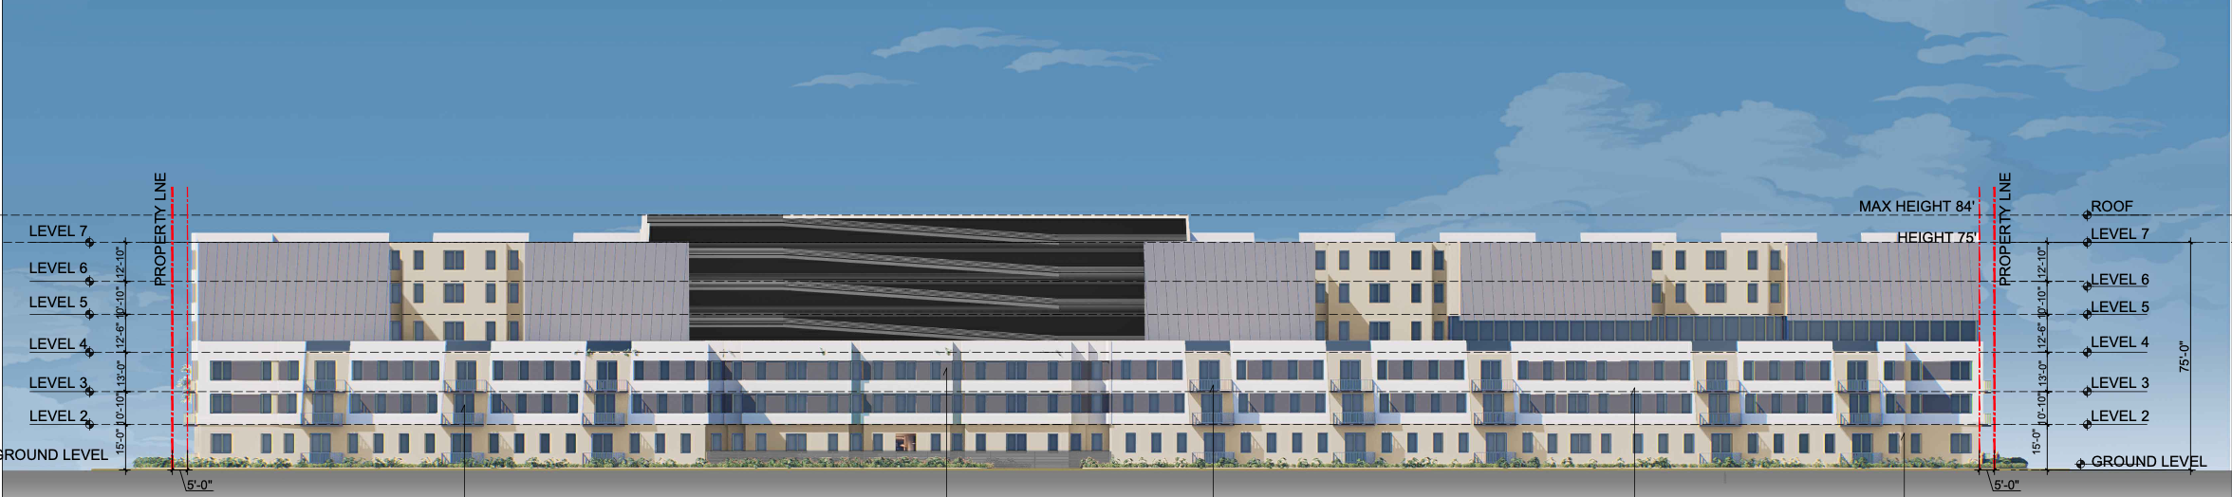
CONSISTENCY with TSDD
§20-8.10 Architectural Standards
Define intent for LEED certification attainment
Entrances and window along all ground level street fronts – improved compatibility for street activation and neighborhood scale
Require additional transparency percentages for window glazing on upper floors
Require specifications for window frames and glass used
Balconies are to be within build-to line
Provide garage screening detail

Slide 14
TRAFFIC IMPACT &
DEVELOPMENT REVIEW COMMITTEE
DRC pending additional detail on sign and sealed sheets

